Slide 1

Comprehensive Analysis on Consumption of Entertainment Sources

Slide 2
Project Members
Aditya Kumar Singh
Aryan Rajput
Javed Mohammed
Priyanka Ashok Sujgure

Slide 3
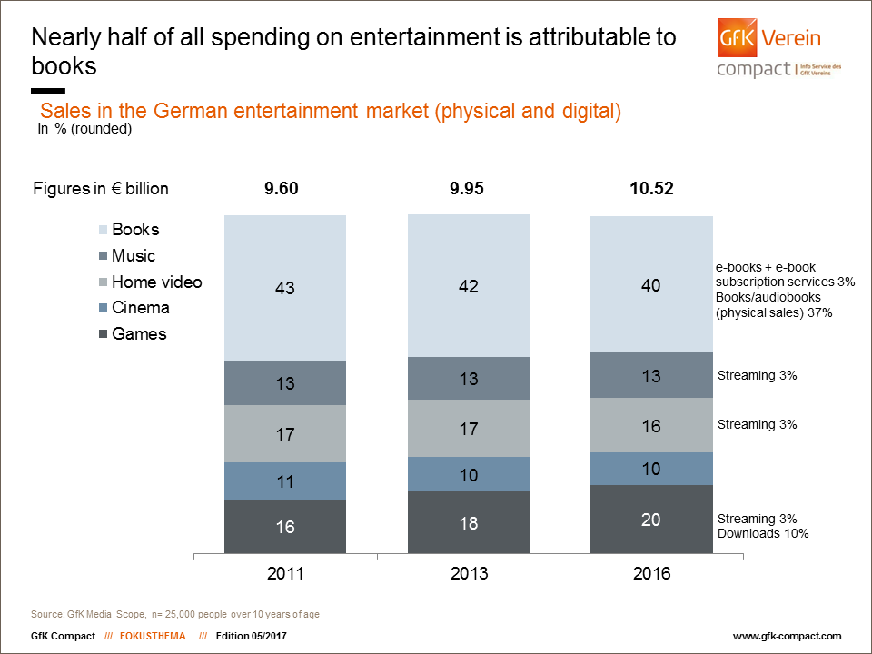
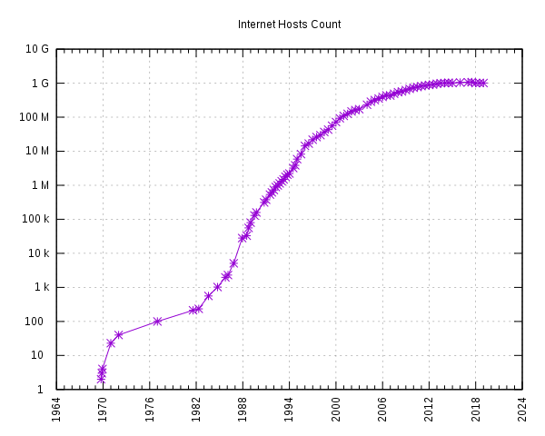
Reason For Selecting Movies, Music, Games and Books
Internet Growth is the driving force behind entertainment industry.

Slide 4
The research question :
•Analyzing trends in each specific entertainment domain.
•Comparative growth study and visualization in the sameframe of time among different domains

Slide 5
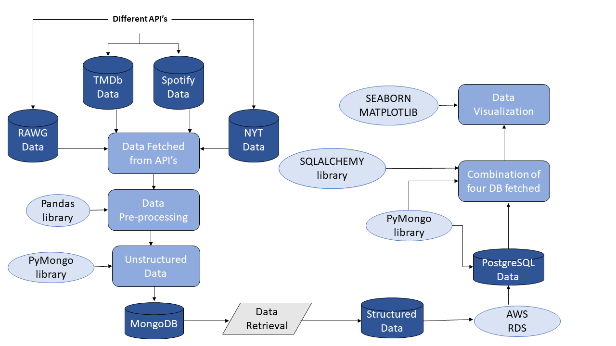
Project Flow Chart

Slide 6
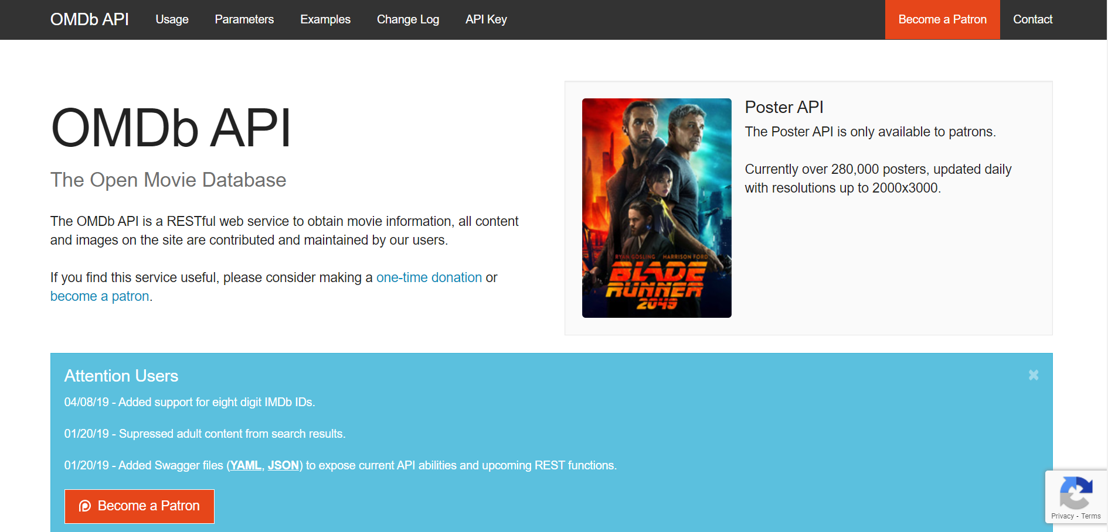
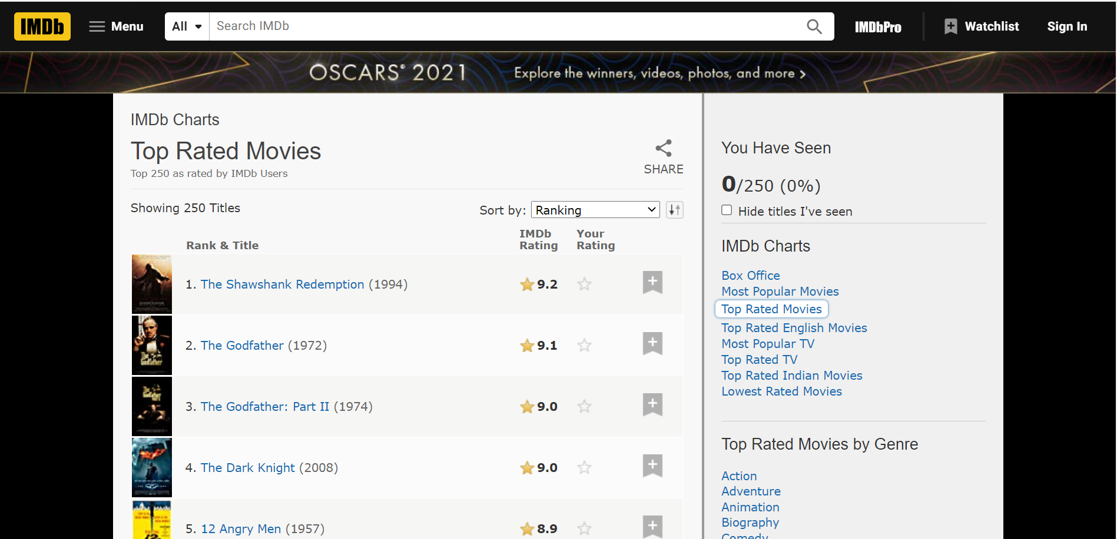
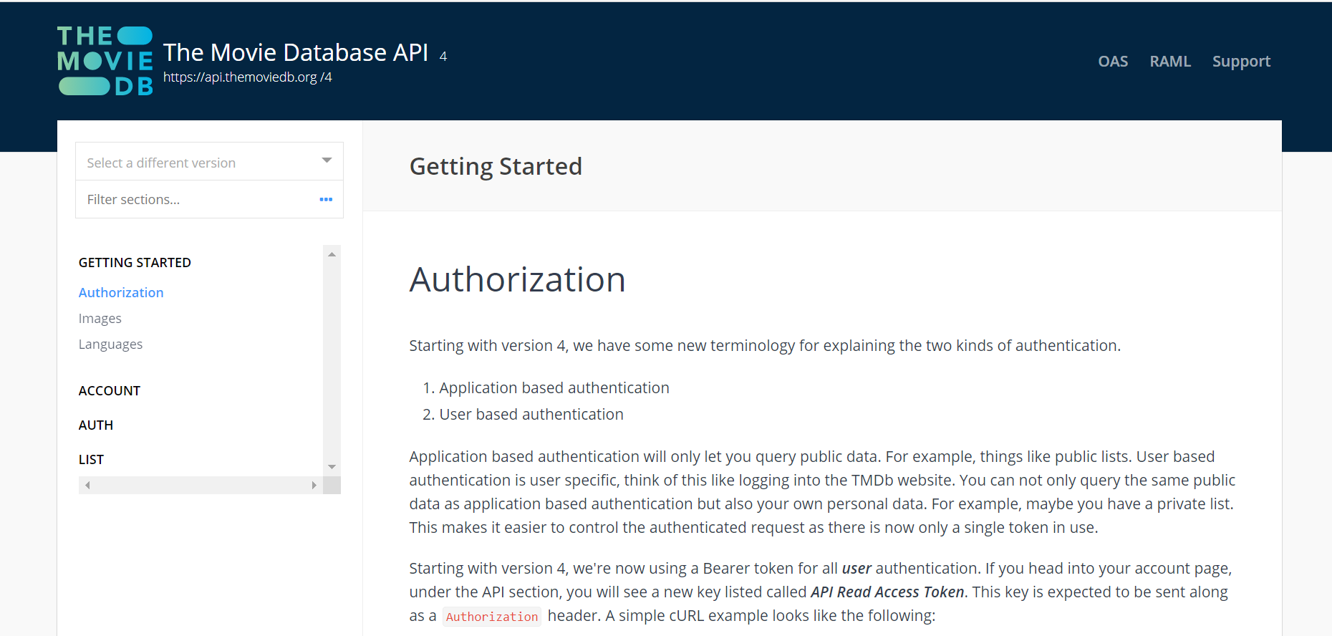
Searching the appropriate API
The category Movies have several options to choose data from.
The most popular once are as mentioned above.
Out of all these API’s TMDb provides free access to data and ability to choose data randomly.
After generating the “API Key” data is fetched from the API.
20 records per hit are fetched.

Slide 7
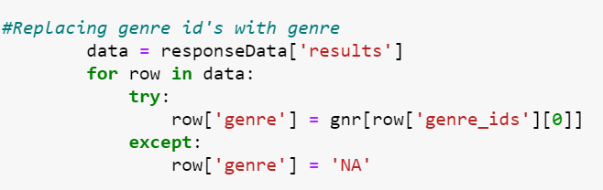
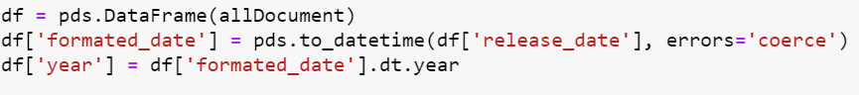
Data Transformation
Original data consists of Genre Id’s instead of genre.
Replacing the Id’s from the Genre table available in the API.
Creation of Data Frame using Pandas library.
As “year” is the key field to analyse the aim of this project extracting the year from column “released_date”.

Slide 8
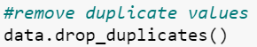
Data Cleaning
Some important steps performed in data cleaning are
Dropping not required columns
Removing duplicates
Deleting records having 0 or missing values

Slide 9
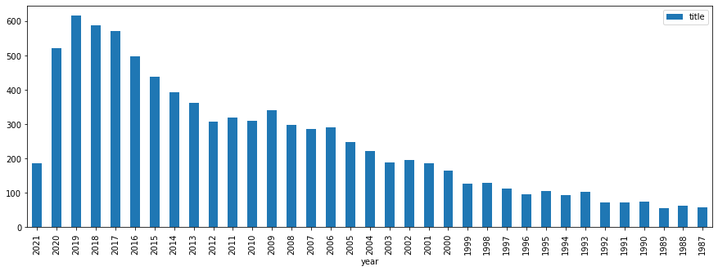
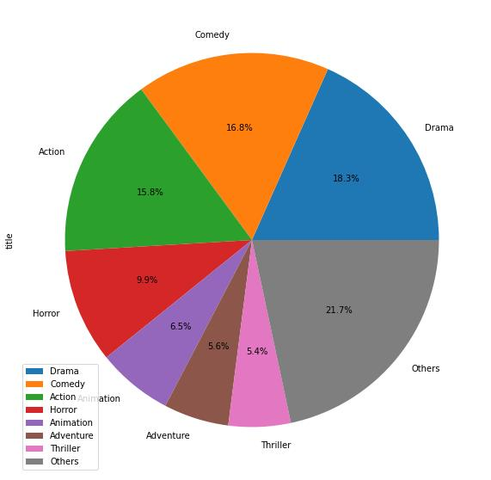
Analysis of the structured data
The bar chart represents the movies produced over the years have increased showing a decrease in 2021 and 2020.
We assume that the reason for this is the global pandemic.
The highest consumed genre for movies are Comedy, Drama and Action as shown in the pie chart.

Slide 10
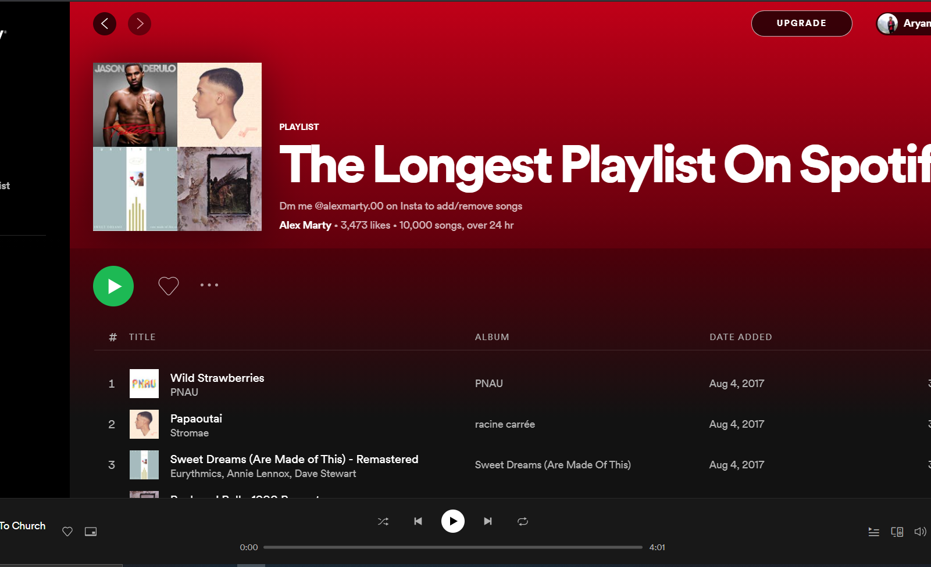
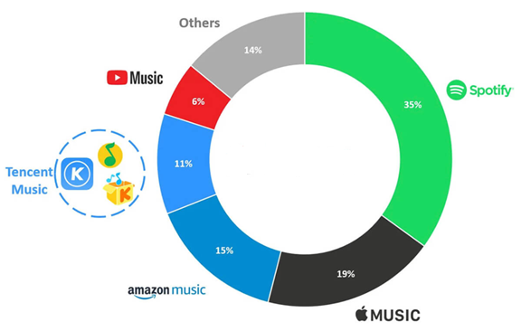
Choosing Music Dataset
Spotify is streaming service which gives subscribers instant access to millions of songs. Spotify has the best music discovery algorithms and the slickest, snappiest user interface.
Spotify has 155 million premium subscribers worldwide.
Spotify's subscriber base has increased dramatically in the last few years and has more than doubled since early 2017

Slide 11
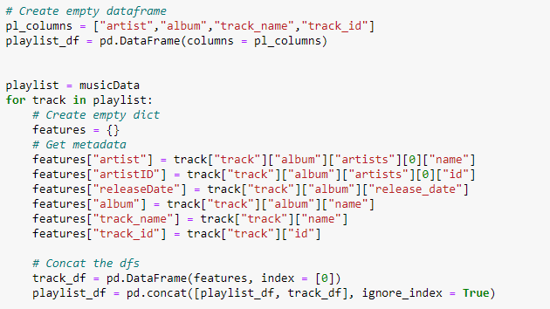
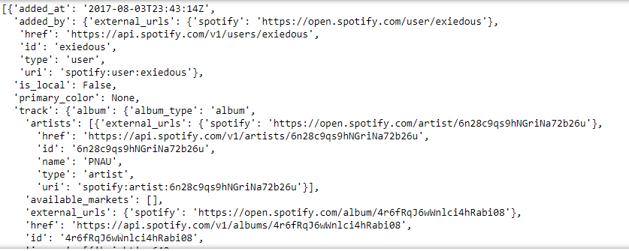
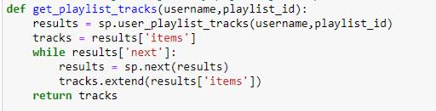
Spotify API Output and Data Extraction
JSON data was nested and complex.
Method used to extract data from JSON objects.

Slide 12
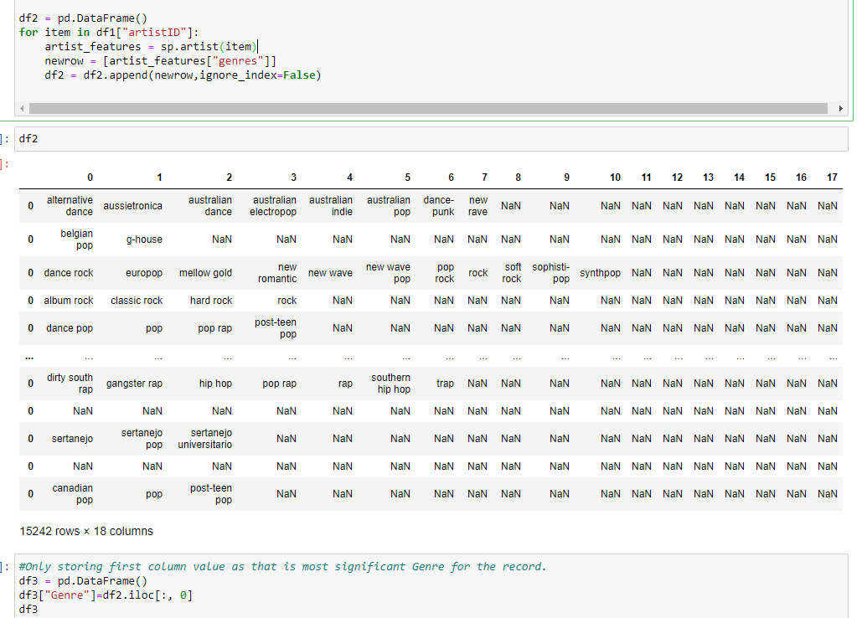
Data Transformation
As Genre was not included in JSON output, I had to use spotify API to get genre by using ArtistID then merge with original Dataset

Slide 13
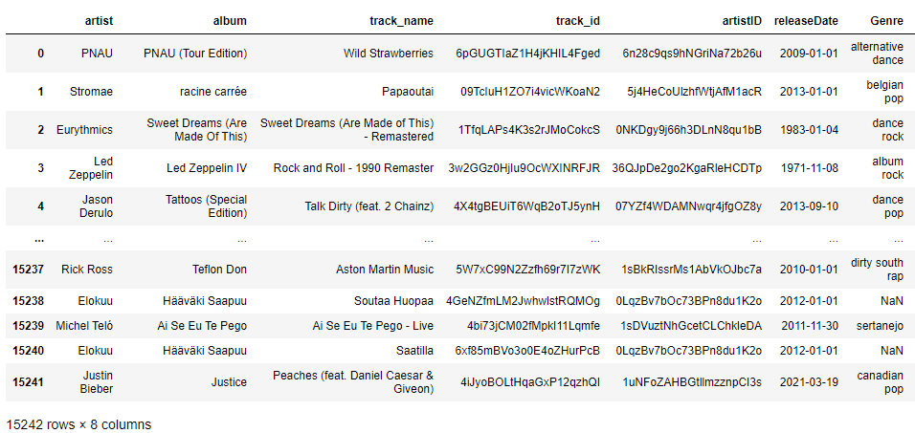
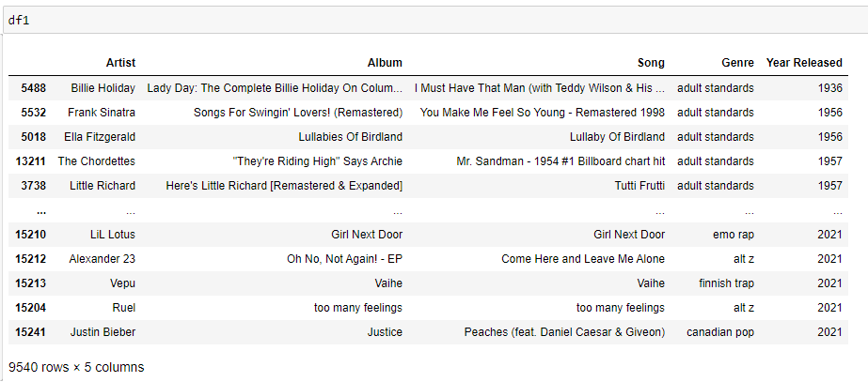
Data Cleaning
Includes non- relevant columns drop, null values removal, duplicates removal.

Slide 14
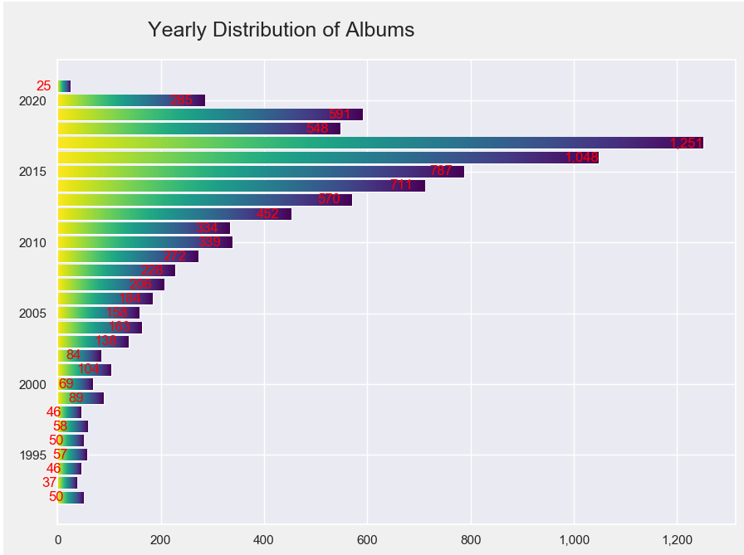
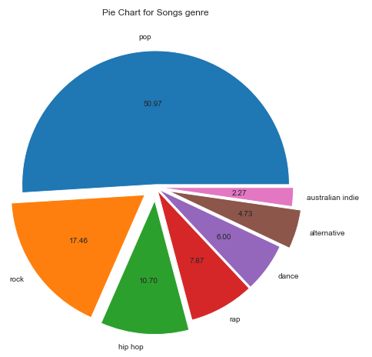
Individual plots to support our analysis

Slide 15
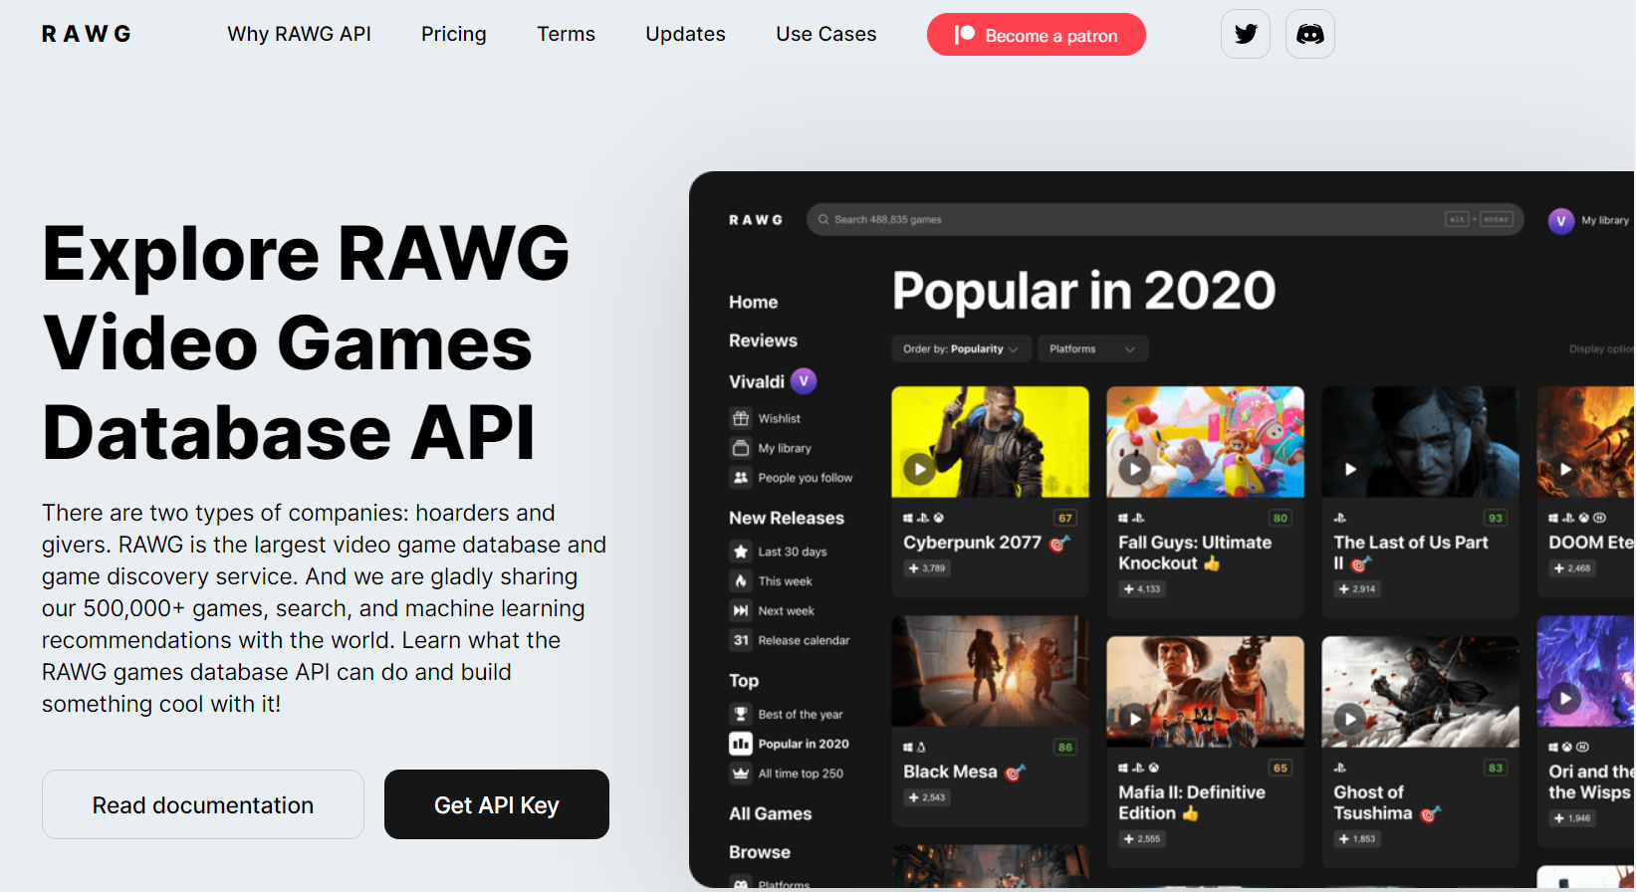
RAWG

Slide 16
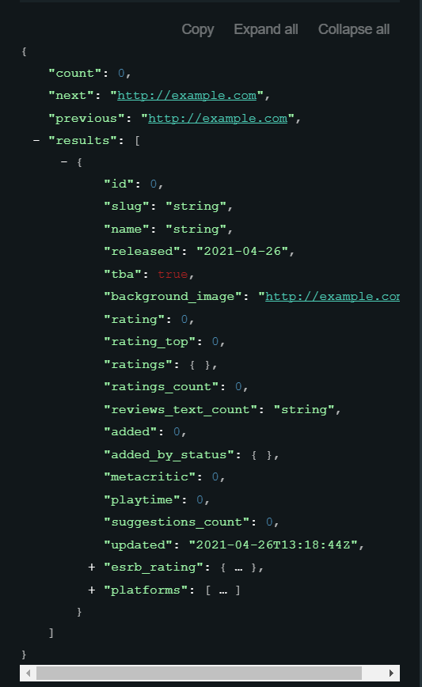
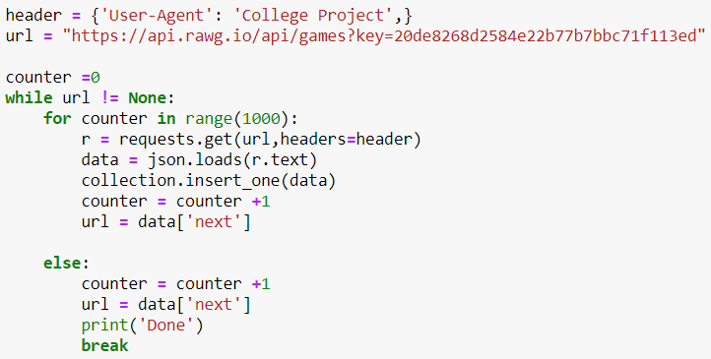
RAWG API Output and Data Extraction

Slide 17
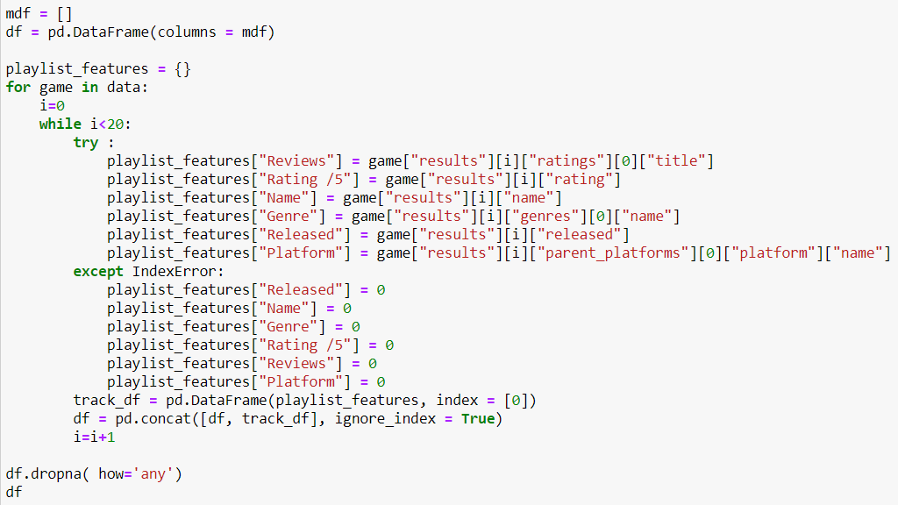
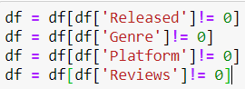
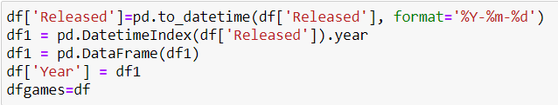
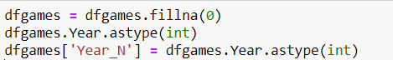

Slide 18
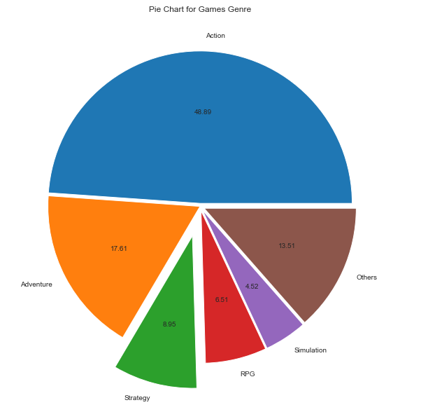
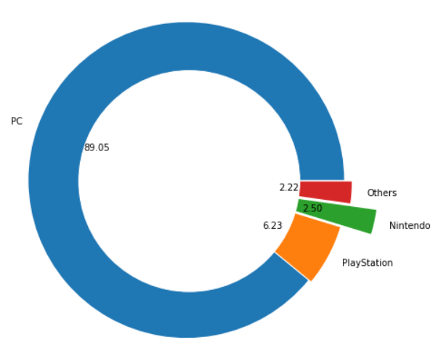
Plots to view genre and games relationship

Slide 19
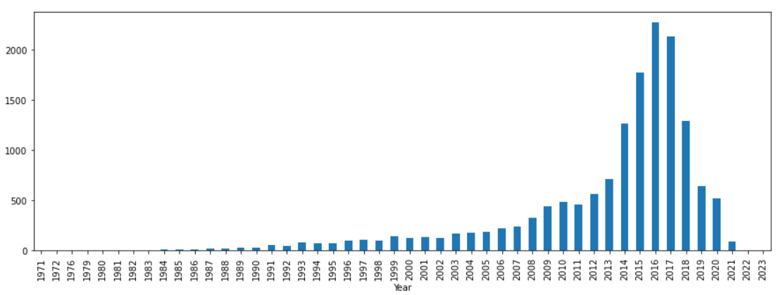
Annual growth of games

Slide 20
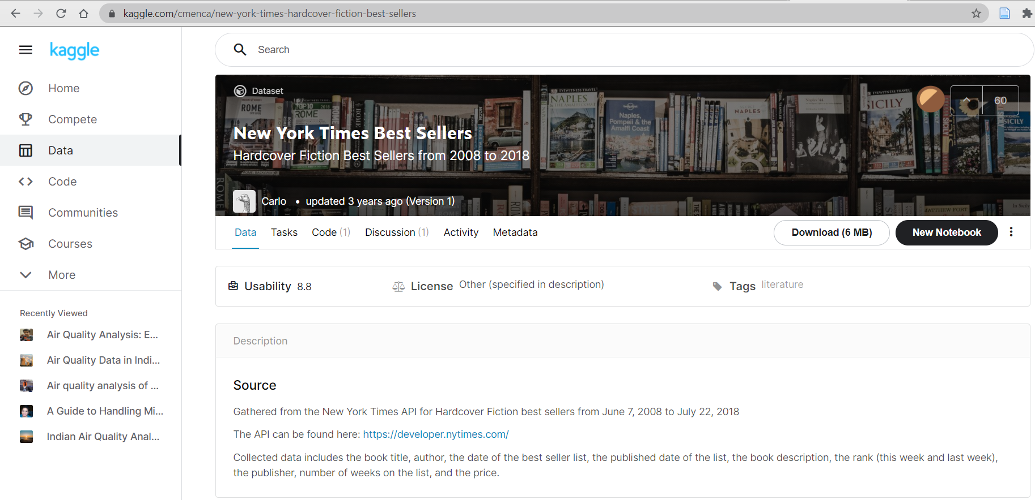
Books Introduction
Entertainment and art have power. Our culture is molded more so by entertainment than any other influence.
In earlier days people use books for the entertainment purpose but as years are being passed, the trend has been decreasing gradually.
This project aims to analyze the different categories of books ranked by NYT Bestsellers based on their publications from the year 2008-2018.

Slide 21
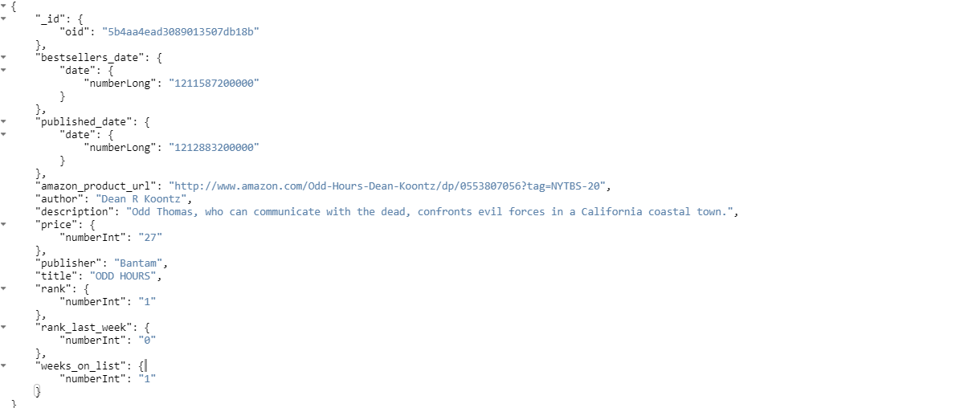
Data Gathering & JSON Input
The New York Times Bestseller List(NYTBL) is the most inﬂuential and prominent lists of the best selling books in the United States.
It holds 10,000 records which contains information about Authors, Rankings, Prices, Published date etc.
Between the two sources, we were able to obtain basic description for the books such as ISBN, author, short descriptions.

Slide 22
Data Pre-Processing
Data Extraction: Retrieved the data from Kaggle and pushed the data into MongoDB Database and saved it in the JSON format.
Data Cleaning: Converted fields from one data type to another where required, examined null values in various fields, excluded duplicates, and eliminated irrelevant data.
Data Transformation: Transferred cleaned data from the Database to the required source destination (Postgre SQL).

Slide 23
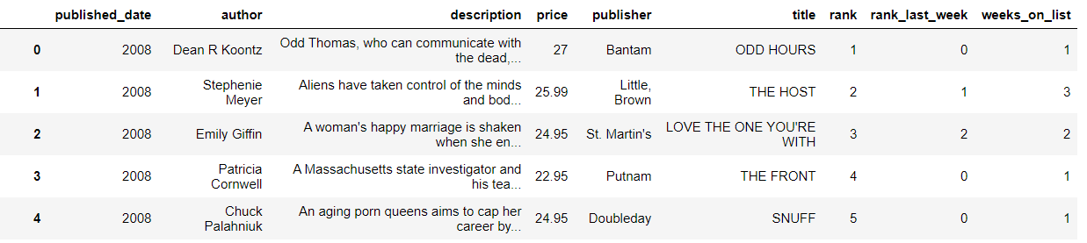
Clean Data

Slide 24
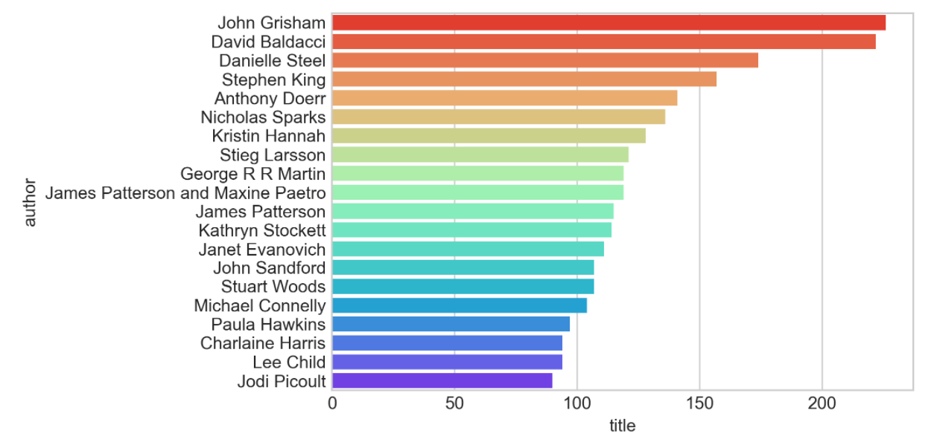
Top 15 Authors

Slide 25
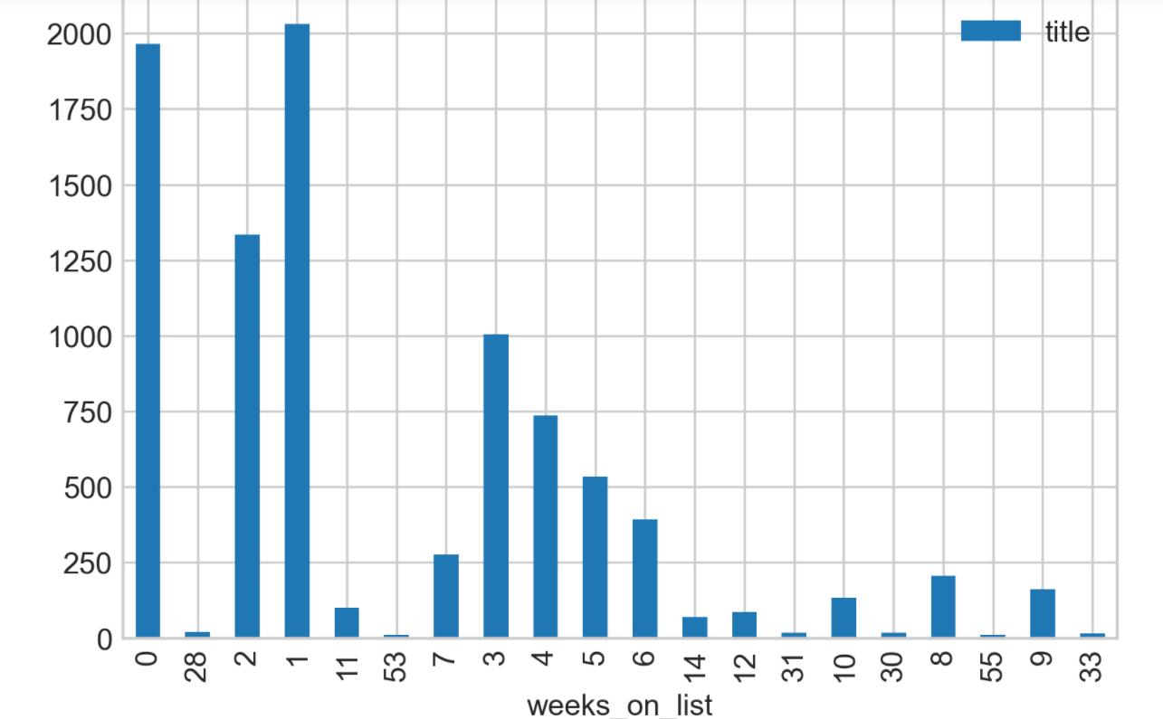
Popular books that lasted more days on the list

Slide 26
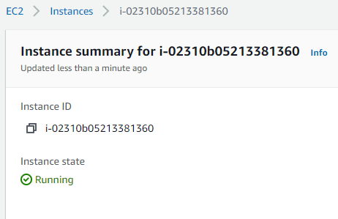
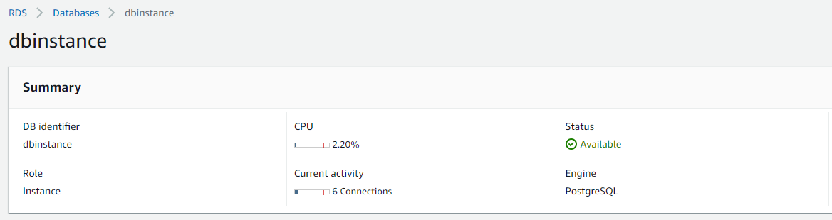
AWS Environment
EC2 instance is created to host Postgres DB on AWS cloud.

Slide 27
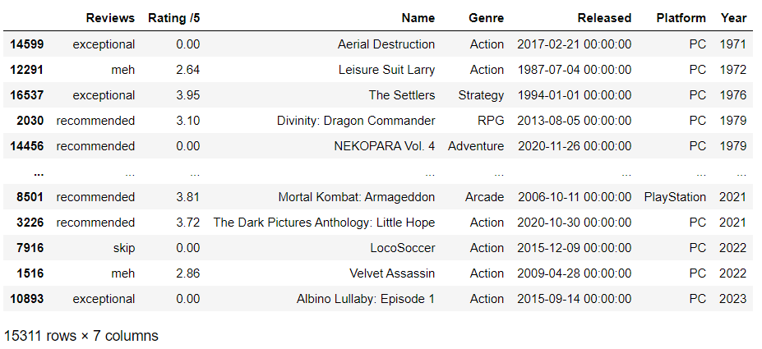
Data push to postgreSQL

Slide 28
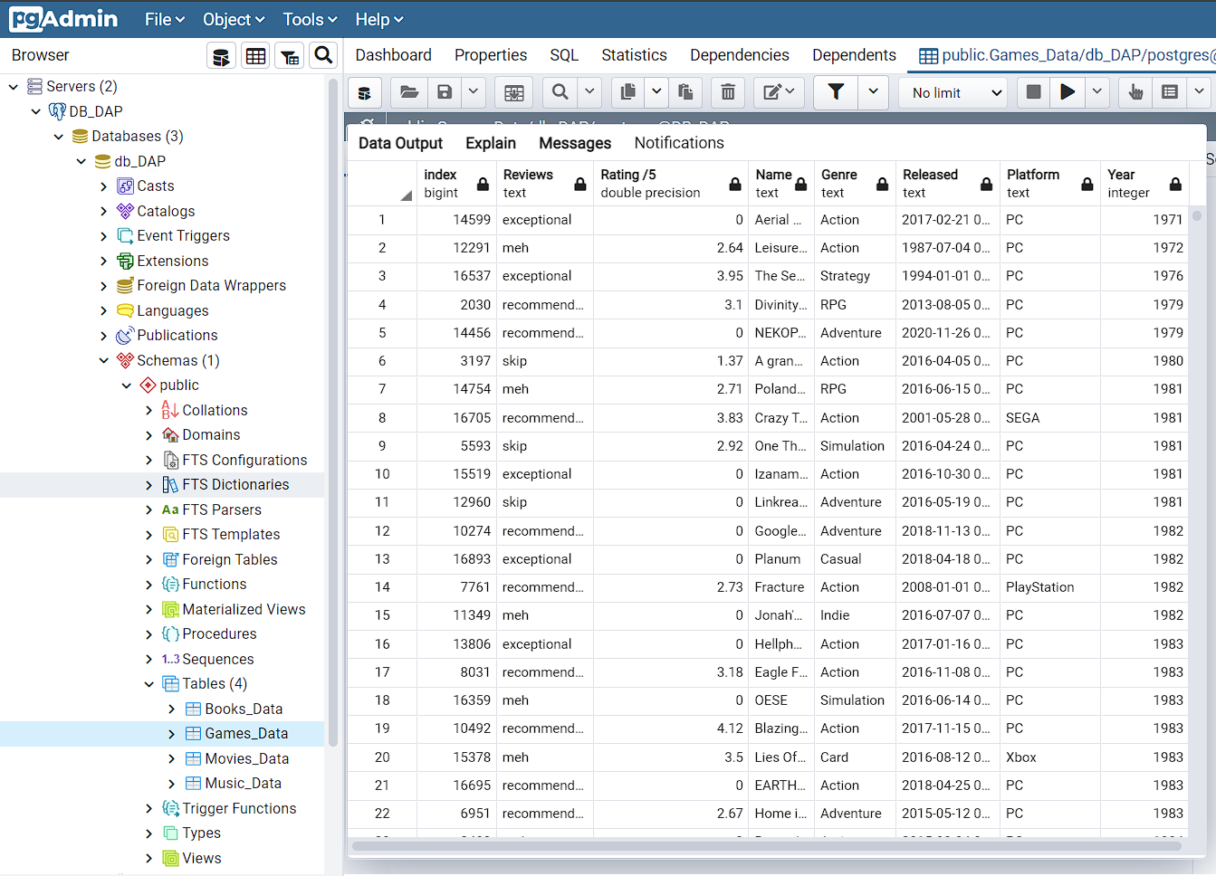
Postgres table view

Slide 29
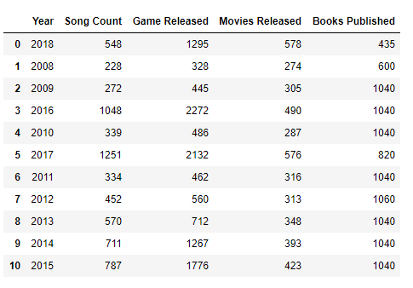
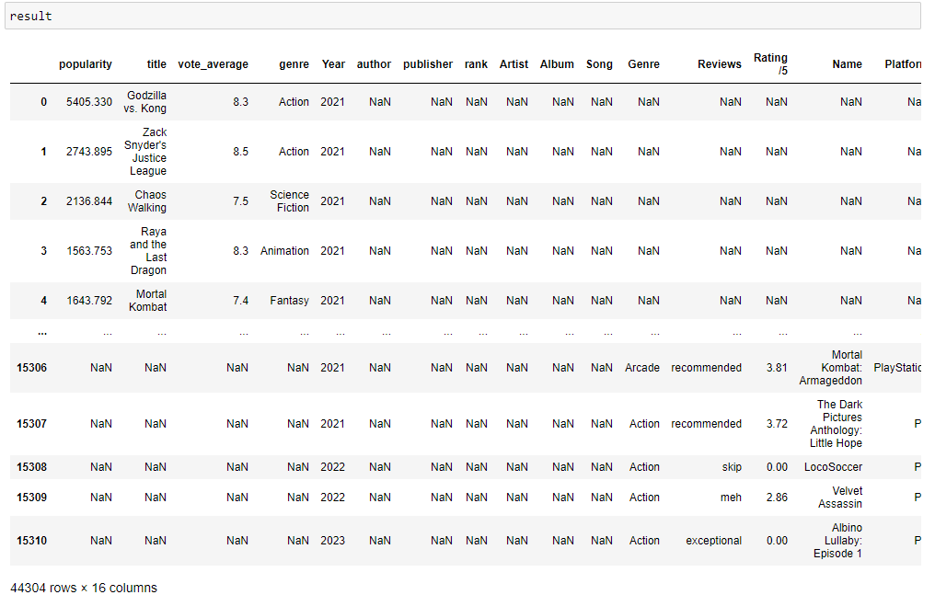
Importing and Combining all datasets
Merge and Append operations were performed to group data together.

Slide 30
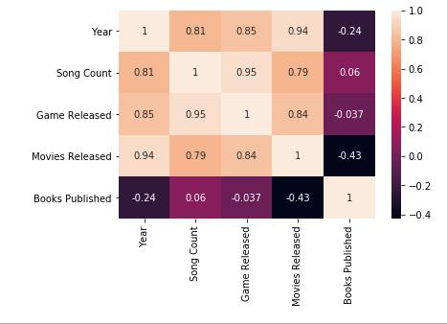
Results & Final Visualization

Slide 31
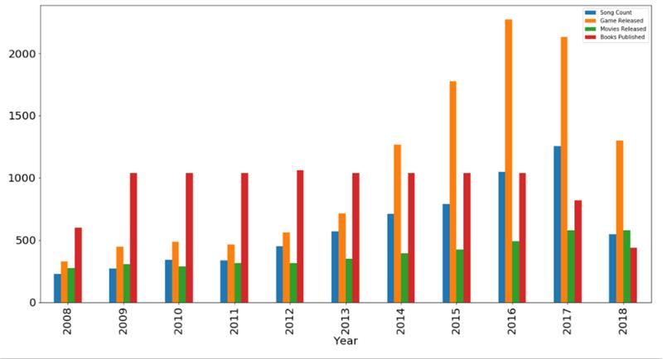
Comparison of all entertainment sources yearly growth

Slide 32
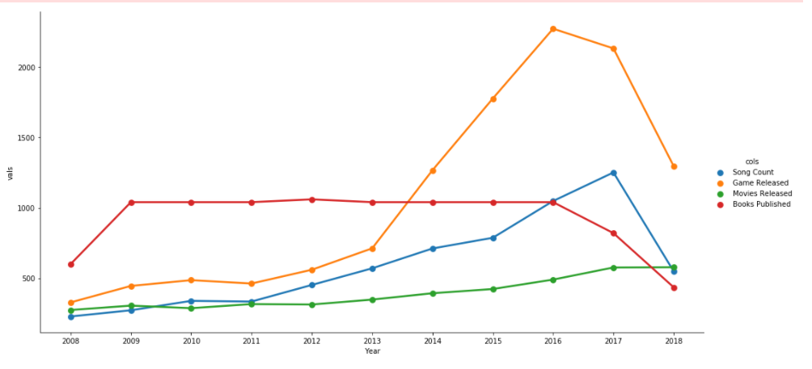
Line chart

Slide 33
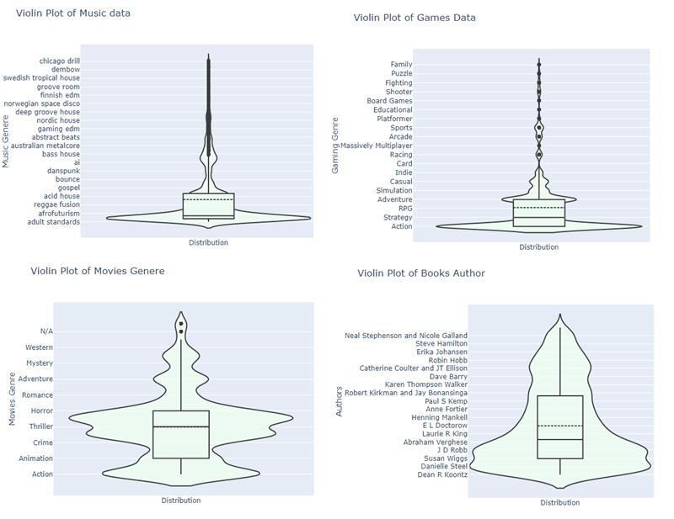
Violin plot of the data distribution

Slide 34
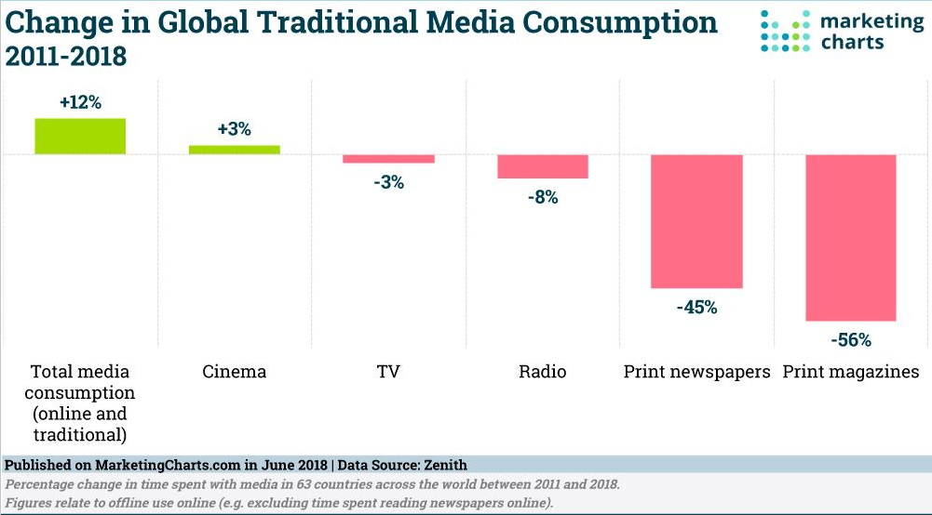
Conclusion

Slide 35
Thank You

